Slide 1
This will be Home screen
Application opening screen @ Washing mc
DENSO
Crafting the Core
Lot Entry Application
DENSO
Crafting the Core
Lot Entry Application
For entry lot no., click on this
Child part Lot Entry
KB-IN
HA229800-1200
KC-IN
HA229800-3240
KC-EX
HA229800-3250
There must be provision of change model name, number in modification section
To add/edit model number, name and child number, name.
To access this credential login id need
User Master
KC-EX(Export)
HA229800-4630
TNGA-IN(70°) HA229800-4590
TNGA-IN(45°) HA229800-4580
TNGA-EX HA229800-4600
ZE-EX(Export)
HA229800-4640
ZE-EX
HA229800-4670
Back
This button is jump to previous page
This button is jump to Model name display Home screen
DENSO
Crafting the Core
Lot Entry Application
Model number
For each model related all child parts display in this page .(refer DNHA part matrix)
Child part Name
Child part Number
Child part Name
Child part Number
Child part Name
Child part Number
Child part Name
Child part Number
Child part Name
Child part Number
Child part Name
Child part Number
Child part Name
Child part Number
Child part Name
Child part Number
Child part Name
Child part Number
Click on respective child part tab for entering lot no. entry (Next page explain)

Slide 2
DENSO
Crafting the Core
Lot Entry Application
From QR code auto entry how, (Que to Sato ?)
Model number-no.
Auto
Auto
From QR code auto entry how, (Que. to Sato ?)
Home
Part Name
Rotor
Part Number
HA229861-2410
TM Name
Anil
Lot Number
Press Enter
TL Name
Amit
Lot Quantity
Shift
B
1. There will be lot digit count pokayoke.
If mismatched then alert.
2. If same lot no. again entered then alert box come & demand confirmation of entering repeat lot no.
( lot no. is repeated in In house machining part entry)
Press Enter
After pressing enter,new row will be displayed at top (latest entered lot info must display at first and follow time)
Auto come as per PC time.
Data picked from entered in modification
Shift | TM name | TL Name | Model name | Model No. | Child Part Name | Child Part No. | Lot Entry Date | Lot Entry Time | Lot no. | Lot Qty
B | Anil | Amit | KB-IN | HA229800-1200 | Rotor | HA229861-2410 | 20-06-2023 | 17:36:23 | S004817704 | 24
B | Anil | Amit | KC-IN | HA229800-3240 | Rotor | HA229861-2440 | 20-06-2023 | 18:06:23 | S004816747 | 24
Export
Edit Lot Entry
Back
For export lot data manually,
New dialogue box open in which From & To date shall be entered.
Select related row & press this button to Edit.
Editable content → Child part no.,Lot entry date,lot entry time,Lot no.,Lot qty.

Slide 3
Model wise child part name list
DENSO
Crafting the Core
Lot Entry Application
KB-IN HA229800-1200
Home
Housing (Inhouse)
HA229871-0781
Rotor (Inhouse)
HA229861-2410
Rotor (CKD)
VN229861-2410
Sprocket (Universal)
HA229852-0700
Sprocket (CKD)
229852-0700
Sprocket (ARUN)
HA229852-0700
Bush Stopper (Local) USHA
HA229873-0080
Bush Stopper (CKD)
229873-0080
Sleeve pin guide
HA229865-0170
Pin Stopper (Local) USHA
HA229863-0190
Pin Stopper (CKD)
229863-0190
Bolt
229827-0340
Bushing Vane (Sundaram)
HA229869-0170
Bushing Vane (Porite)
HA229869-1560
Spring Stopper
229867-0070
Chip Vane seal
229884-0010
Spring vane seal
229885-0010

Slide 4
Model wise child part name list
DENSO
Crafting the Core
Lot Entry Application
KC-IN HA229800-3240
Home
Housing (Inhouse)
HA229871-1920
Rotor (Inhouse)
HA229861-2850
Rotor (CKD)
VN229861-2850
Sprocket (Sundaram)
HA229852-1560
Sprocket (Porite)
HA229852-2300
Bush Stopper (Local)
HA229873-0250
Sleeve pin guide
HA229865-0140
Pin Stopper (Local)
HA229863-1390
Bolt
229827-0340
Bushing Vane (Sundaram)
HA229869-0170
Bushing Vane (Porite)
HA229869-1560
Spring Stopper
229867-0070
Chip Vane seal
229884-0010
Spring vane seal
229885-0010

Slide 5
Model wise child part name list
DENSO
Crafting the Core
Lot Entry Application
KC-EX HA229800-3250
Home
Housing (Inhouse)
HA229871-1810
Housing (SMAC)
HA229871-2660
Rotor (Inhouse)
HA229861-2420
Rotor (CKD)
229861-2420
Sprocket (Sundaram)
HA229852-1570
Sprocket (Porite)
HA 229852-2310
Sprocket (CKD)
229852-1570
Bush Stopper (Local) USHA
HA229827-0140
Bush Stopper (China) GN229873-0530
Sleeve pin guide
HA229865-0170
Pin Stopper (Local) USHA
HA229863-1030
Pin Stopper (China)
GN229863-1030
Bolt
229827-0340
Bushing Vane (Sundaram)
HA229869-0920
Bushing Vane (Porite)
HA229869-1570
Spring Stopper
229867-0320
Chip Vane seal
229884-0130
Spring vane seal
229885-0010
Rotor Pin Position
229829-0030
Retard Pin Position
229829-0190
Spring Retard
229826-0210

Slide 6
Model wise child part name list
DENSO
Crafting the Core
Lot Entry Application
KC-EX HA229800-4630 (Export)
Home
Housing (Inhouse)
HA229871-1810
Rotor (Inhouse)
HA229861-2420
Sprocket (Sundaram)
HA229852-1570
Sprocket (Porite)
HA 229852-2310
Sprocket (CKD)
229852-1570
Bush Stopper (Local) USHA
HA229827-0140
Bush Stopper (China) GN229873-0530
Sleeve pin guide
HA229865-0170
Pin Stopper (Local) USHA
HA229863-1030
Pin Stopper (China)
GN229863-1030
Bolt
229827-0340
Bushing Vane (Sundaram)
HA229869-0920
Bushing Vane (Porite)
HA229869-1570
Spring Stopper
229867-0320
Chip Vane seal
229884-0130
Spring vane seal
229885-0010
Rotor Pin Position
229829-0030
Retard Pin Position
229829-0190
Spring Retard
229826-0210

Slide 7
Model wise child part name list
DENSO
Crafting the Core
Lot Entry Application
TNGA-IN(70°) HA229800-4590
Home
Housing
HA 229871-2620
Rotor (70°)
HA229861-4380
Bush Stopper Rear Plate JK229876-0460
Housing Plate
JK229882-1100
Ball Check Valve
230538-0010
Spring Valve
230544-0080
Sleeve ball guide
229892-0010
Bush Stopper
229873-0630
Sleeve pin guide
HA229865-0410
Bush Ball Stopper
229891-0010
Chip Vane seal
229884-0170
Spring vane seal
229885-0130
Pin Stopper
229863-1670
Spring Stopper
229867-0560
Bolt
229827-0740

Slide 8
Model wise child part name list
DENSO
Crafting the Core
Lot Entry Application
TNGA-IN(45°) HA229800-4580
Home
Housing
HA 229871-2620
Rotor (45°)
HA229861-4420
Bush Stopper Rear Plate JK229876-0460
Housing Plate
JK229882-1100
Ball Check Valve
230538-0010
Spring Valve
230544-0080
Sleeve ball guide
229892-0010
Bush Stopper
229873-0630
Sleeve pin guide
HA229865-0410
Bush Ball Stopper
229891-0010
Chip Vane seal
229884-0170
Spring vane seal
229885-0130
Pin Position
229829-0490
Pin Stopper
229863-1670
Spring Stopper
229867-0560
Bolt
229827-0740

Slide 9
Model wise child part name list
DENSO
Crafting the Core
Lot Entry Application
TNGA-EX HA229800-4600
Home
Housing
HA 229871-2630
Rotor
DH229861-4210
Sprocket
HA229852-2120
Ball Check Valve
230538-0010
Spring Valve
230544-0080
Sleeve ball guide
229892-0010
Bush Stopper
229873-0630
Sleeve pin guide
HA229865-0410
Bush Ball Stopper
229891-0010
Chip Vane seal
230538-0010
Spring vane seal
229885-0010
Pin Position
229829-0490
Pin Stopper
229863-1670
Spring Stopper
229867-0560
Bolt
229827-0740

Slide 10
Model wise child part name list
DENSO
Crafting the Core
Lot Entry Application
ZE-EX(Export) HA229800-4640
Home
Housing
HA 229871-2670
Rotor
HA229861-4472
Rear Plate
HA229876-0471
Housing Plate
JK229882-1110
Bush Stopper
229873-0610
Chip Vane seal
229884-0280
Spring vane seal
GN229885-0200
Pin Stopper
229863-1690
Spring Stopper
229867-0550
Bolt
229827-0860

Slide 11
Model wise child part name list
DENSO
Crafting the Core
Lot Entry Application
ZE-EX HA229800-4670
Home
Housing
HA 229871-2670
Rotor
HA229861-4472
Rear Plate
HA229876-0471
Housing Plate
JK229882-1110
Bush Stopper
229873-0610
Chip Vane seal
229884-0280
Spring vane seal
GN229885-0200
Pin Stopper
229863-1690
Spring Stopper
229867-0550
Bolt
229827-0860

Slide 12
User Master
DENSO
Crafting the Core
Lot Entry Application
Add New Model
Add New Child Part
Add Shift Time
Lot Number & Quantity
Admin
(Manage password)
Back

Slide 13
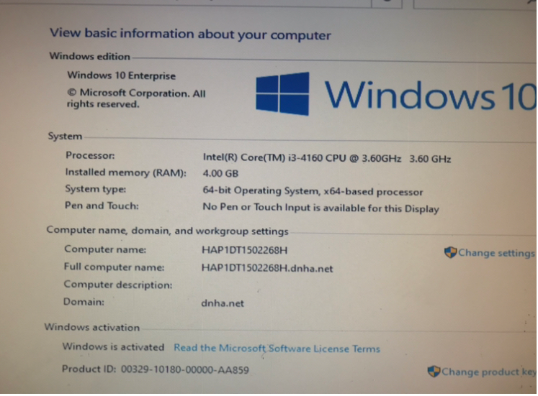
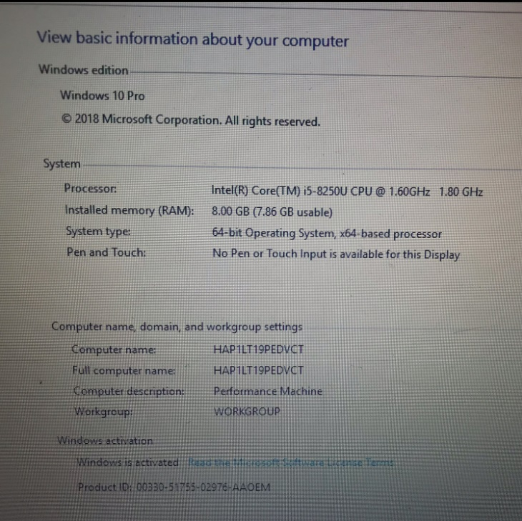
PC specifications
Washing Machine PC
Performance Machine Laptop
We are having these spec, SATO have to design app and system according to this.

